Slide 1
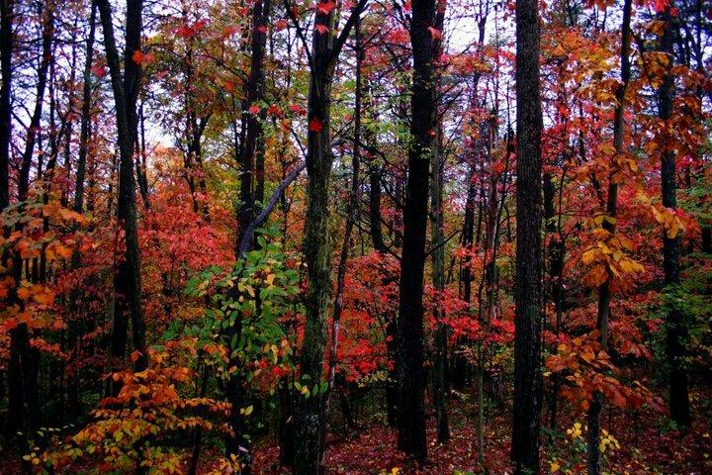
NEW YORK FORESTS
AN ENDANGERED SPECIES?

Slide 2
TREES ARE GOOD
ONETREE = OXYGEN FOR TWO PEOPLE
CARBON SEQUESTRATION
WATER PURIFICATION
EROSION & FLOOD CONTROL
WILDLIFE HABITAT
RECREATION
60,000 JOBS
$4.6 BILLION INCOME, EXCLUDING TOURISM
QUALITY OF LIFE

Slide 3
N Y FOREST HISTORY
DATE % FOREST COVER DEER/SQUARE MILE
1600 95% 5 – 10

Slide 4
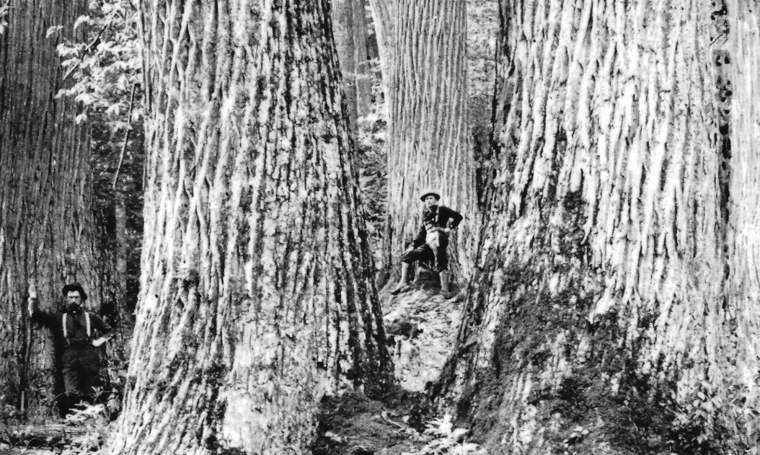

Slide 5
N Y FOREST HISTORY
DATE % FOREST COVER DEER/SQUARE MILE
1600 95% 5 – 10
1880 15% 0

Slide 6
N Y FOREST HISTORY
DATE % FOREST COVER DEER/SQUARE MILE
1600 95% 5 – 10
1880 15% 0
1960 60% (EST.) UP TO 50

Slide 7
N Y FOREST HISTORY
DATE % FOREST COVER DEER/SQUARE MILE
1600 95% 5 - 10
1880 15% 0
1960 60% (EST.) UP TO 50
2013 63% 10 - 50

Slide 8
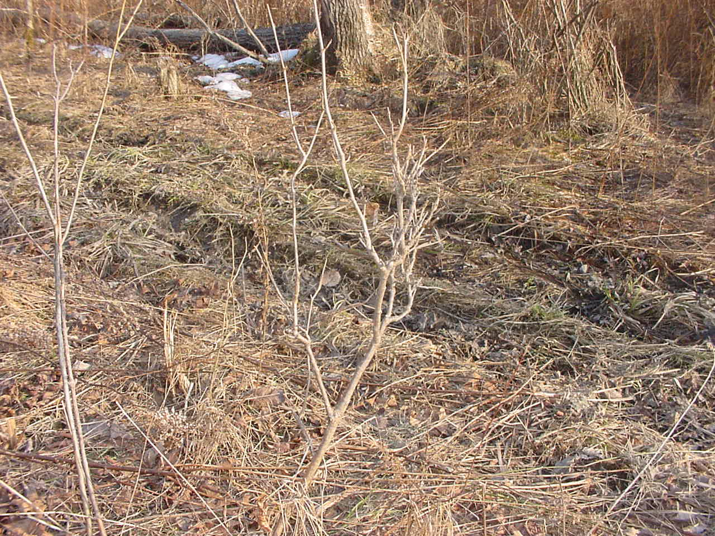

Slide 9
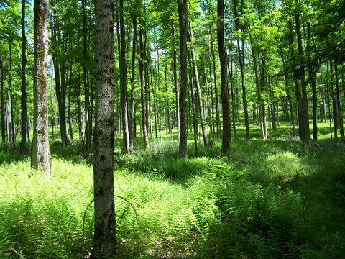

Slide 10
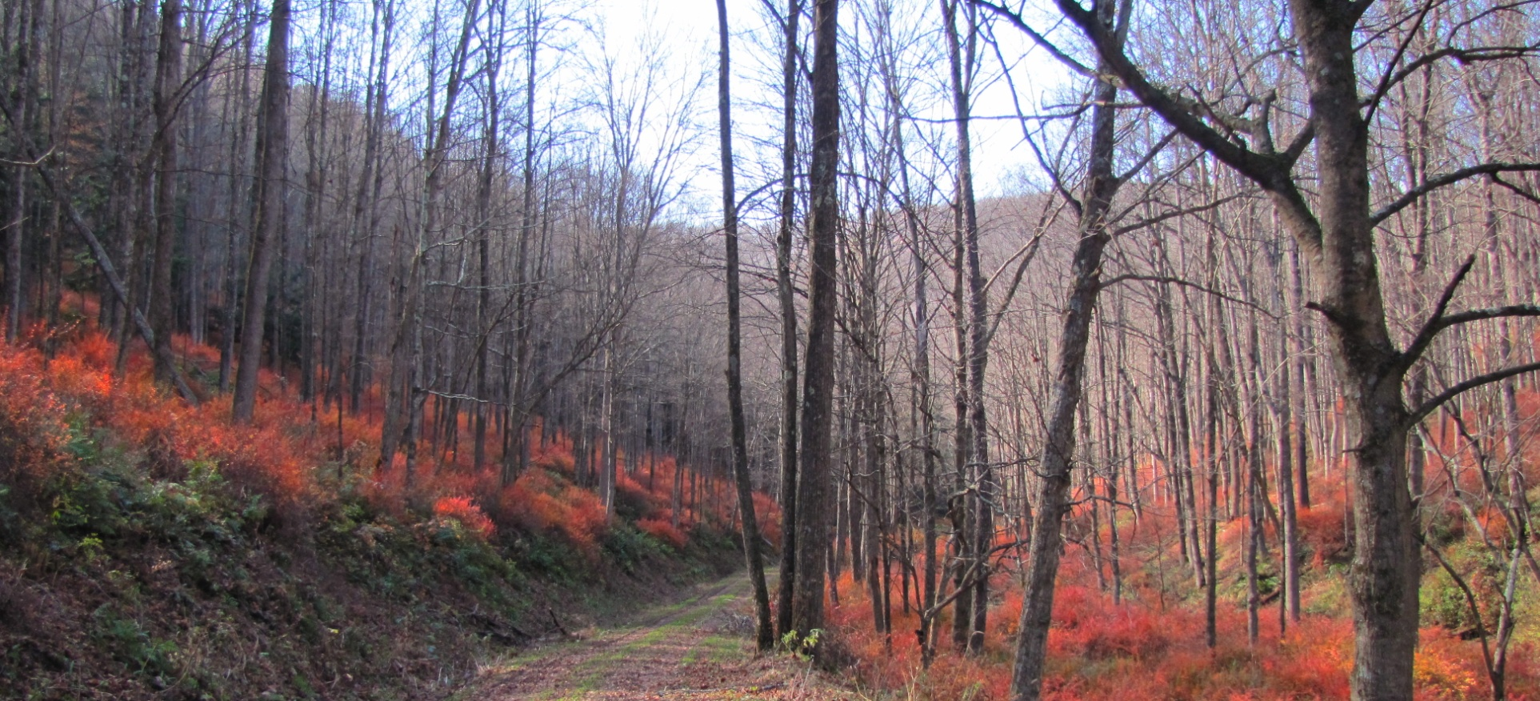

Slide 11
2010 CORNELL STUDY
INPUT FROM 197 FORESTERS
“HARDWOOD REGENERATION IS … SUCCESSFUL
IN ONLY 30% OF FOREST STANDS”

Slide 12
2010 STUDY BY THE NATURE CONSERVANCY
BASED ON 1647 USDA
FOREST INVENTORY DATA PLOTS
“REGENERATION ADEQUATE
ON ONLY 43% OF DATA PLOTS”

Slide 13
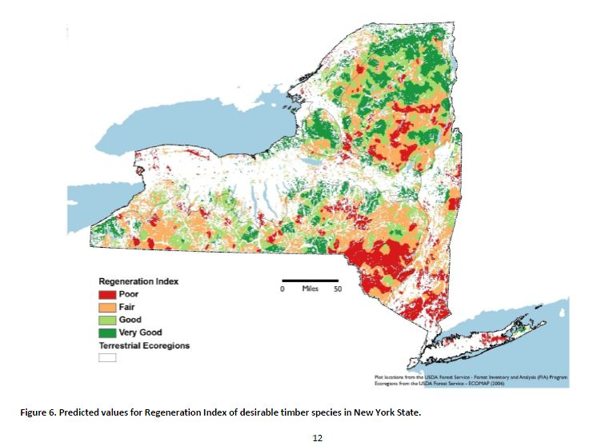

Slide 14
AGE RANGE OF SECONDARY FORESTS
60 TO 120 YEARS
AVERAGE TREE LIFE
80 TO 160 YEARS
WITHOUT REGENERATION, WHAT WILL OUR
FORESTS LOOK LIKE IN FIFTY YEARS WHEN MOST
OF THE CURRENT TREES ARE GONE ?

Slide 15
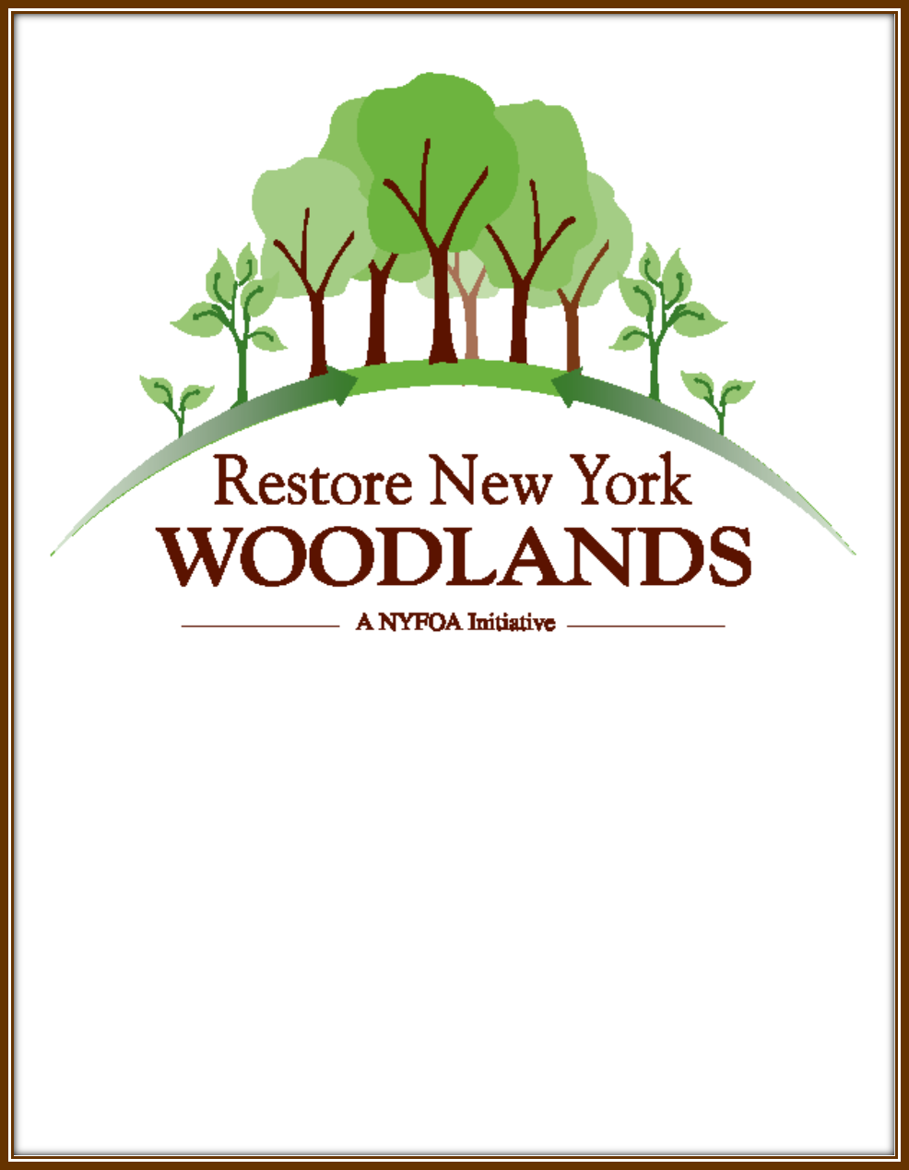

Slide 16
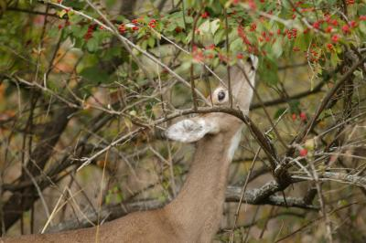
SOLUTIONS INCLUDE
MANAGING DEER
REDUCING POPULATION
INCREASING HUNTER ACCESS
EXPENSIVE FENCING

Slide 17
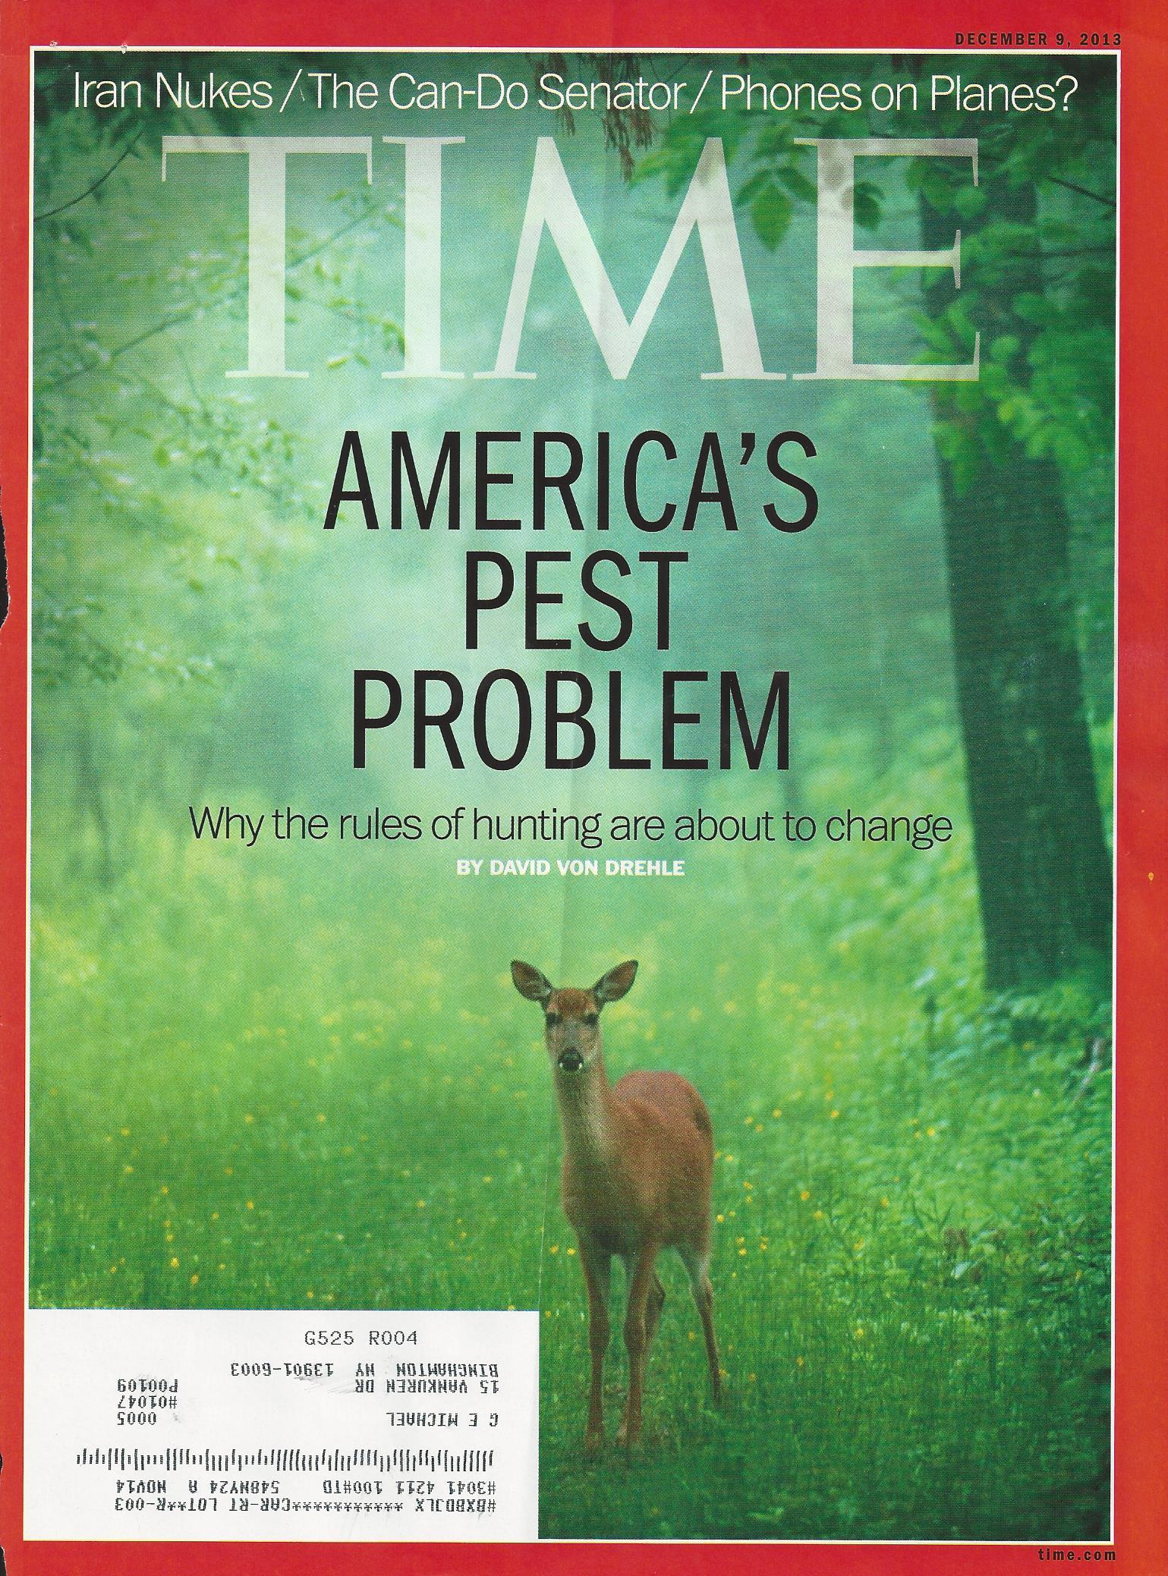

Slide 18
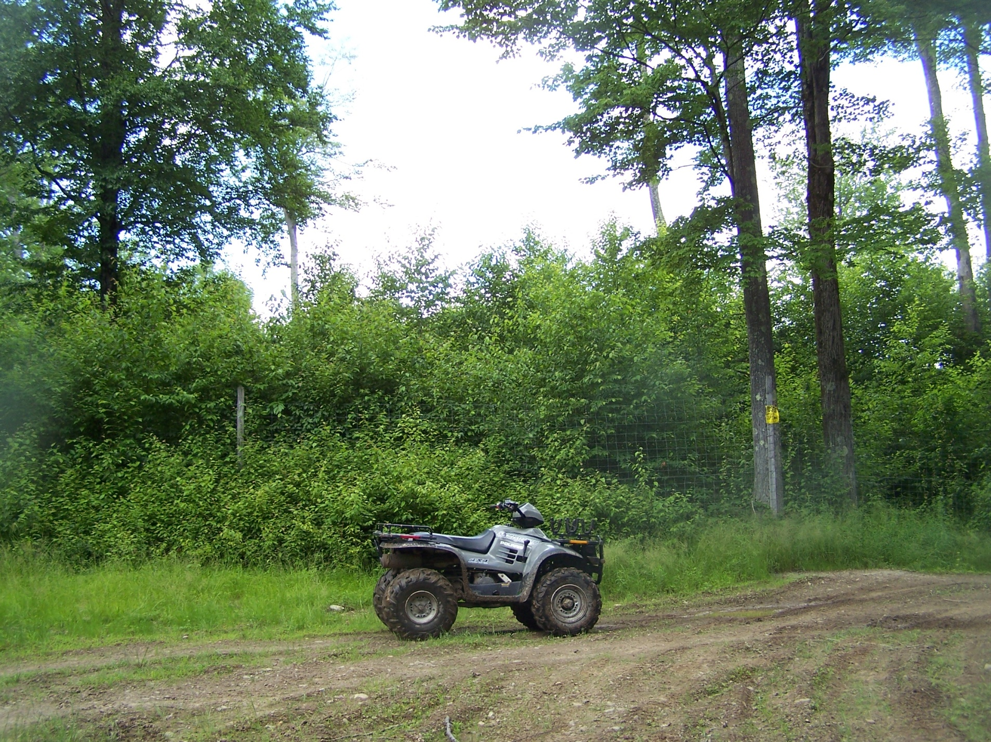

Slide 19
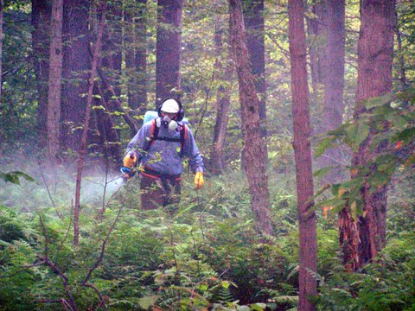
SOLUTIONS INCLUDE
MANAGING INVASIVE AND INTERFERING VEGETATION

Slide 20
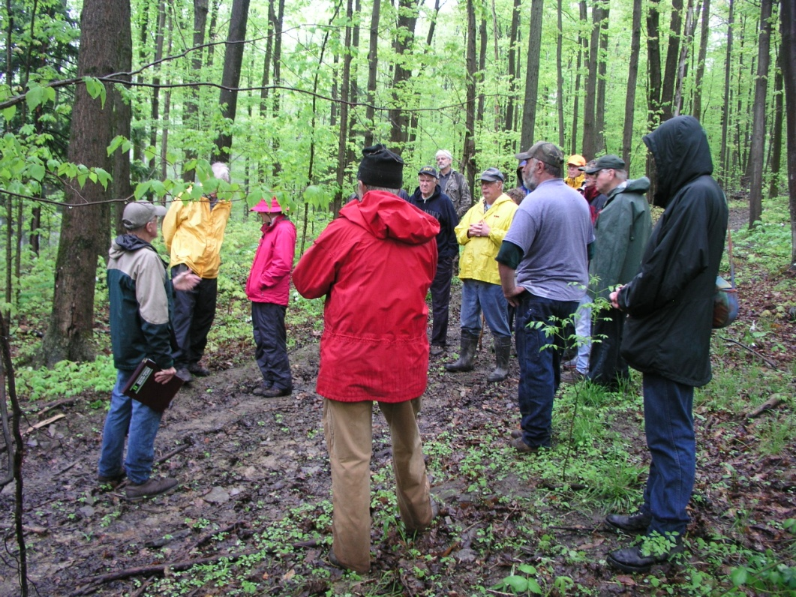
SOLUTIONS INCLUDE
EDUCATION
PUBLIC OUTREACH
ADVOCACY

Slide 21
TREES ARE GOOD
ONETREE = OXYGEN FOR TWO PEOPLE
CARBON SEQUESTRATION
WATER PURIFICATION
EROSION & FLOOD CONTROL
WILDLIFE HABITAT
RECREATION
60,000 JOBS
$4.6 BILLION INCOME, EXCLUDING TOURISM
QUALITY OF LIFE

Slide 22
